Slide 1
B2B Dashboard
BROWN BAG SESSION – 03/29/2023
- Shruti Tripathi

Slide 2
What Is PROJECT BACKBONE?
Purpose
Background: Small businesses are the backbone of our economy, society and life (hence the project name)! Everyone either shops at a small business, knows someone who owns a small business or even owns a business themselves. When it comes to operating a business, there is a critical need to ensure you are partnered with suppliers who can meet your buying needs. Walmart estimates that there is upwards of a $4 Trillion addressable market, upwards of 24 million businesses, and a trend towards digital purchasing that we, as the world's largest retailer, have yet to tap into. Given our broad assortment, eCommerce and Store capabilities, and EDLP strategy, we believe that Walmart not only has the license to operate in this space but the ability to solve problems for customers in ways that other B2B offerings cannot. Therefore, Walmart is seeking to enter the B2B market to meet the growing and changing needs of businesses.
Project Backbone exists to save S&M businesses, governments and nonprofits time, money and hassle so they can focus on their missions!
Our Value Proposition to our Customers:
Simplify and save money on purchases
Stay in control and in stock with more time to focus on what matters
Operate better and grow your business

Slide 3
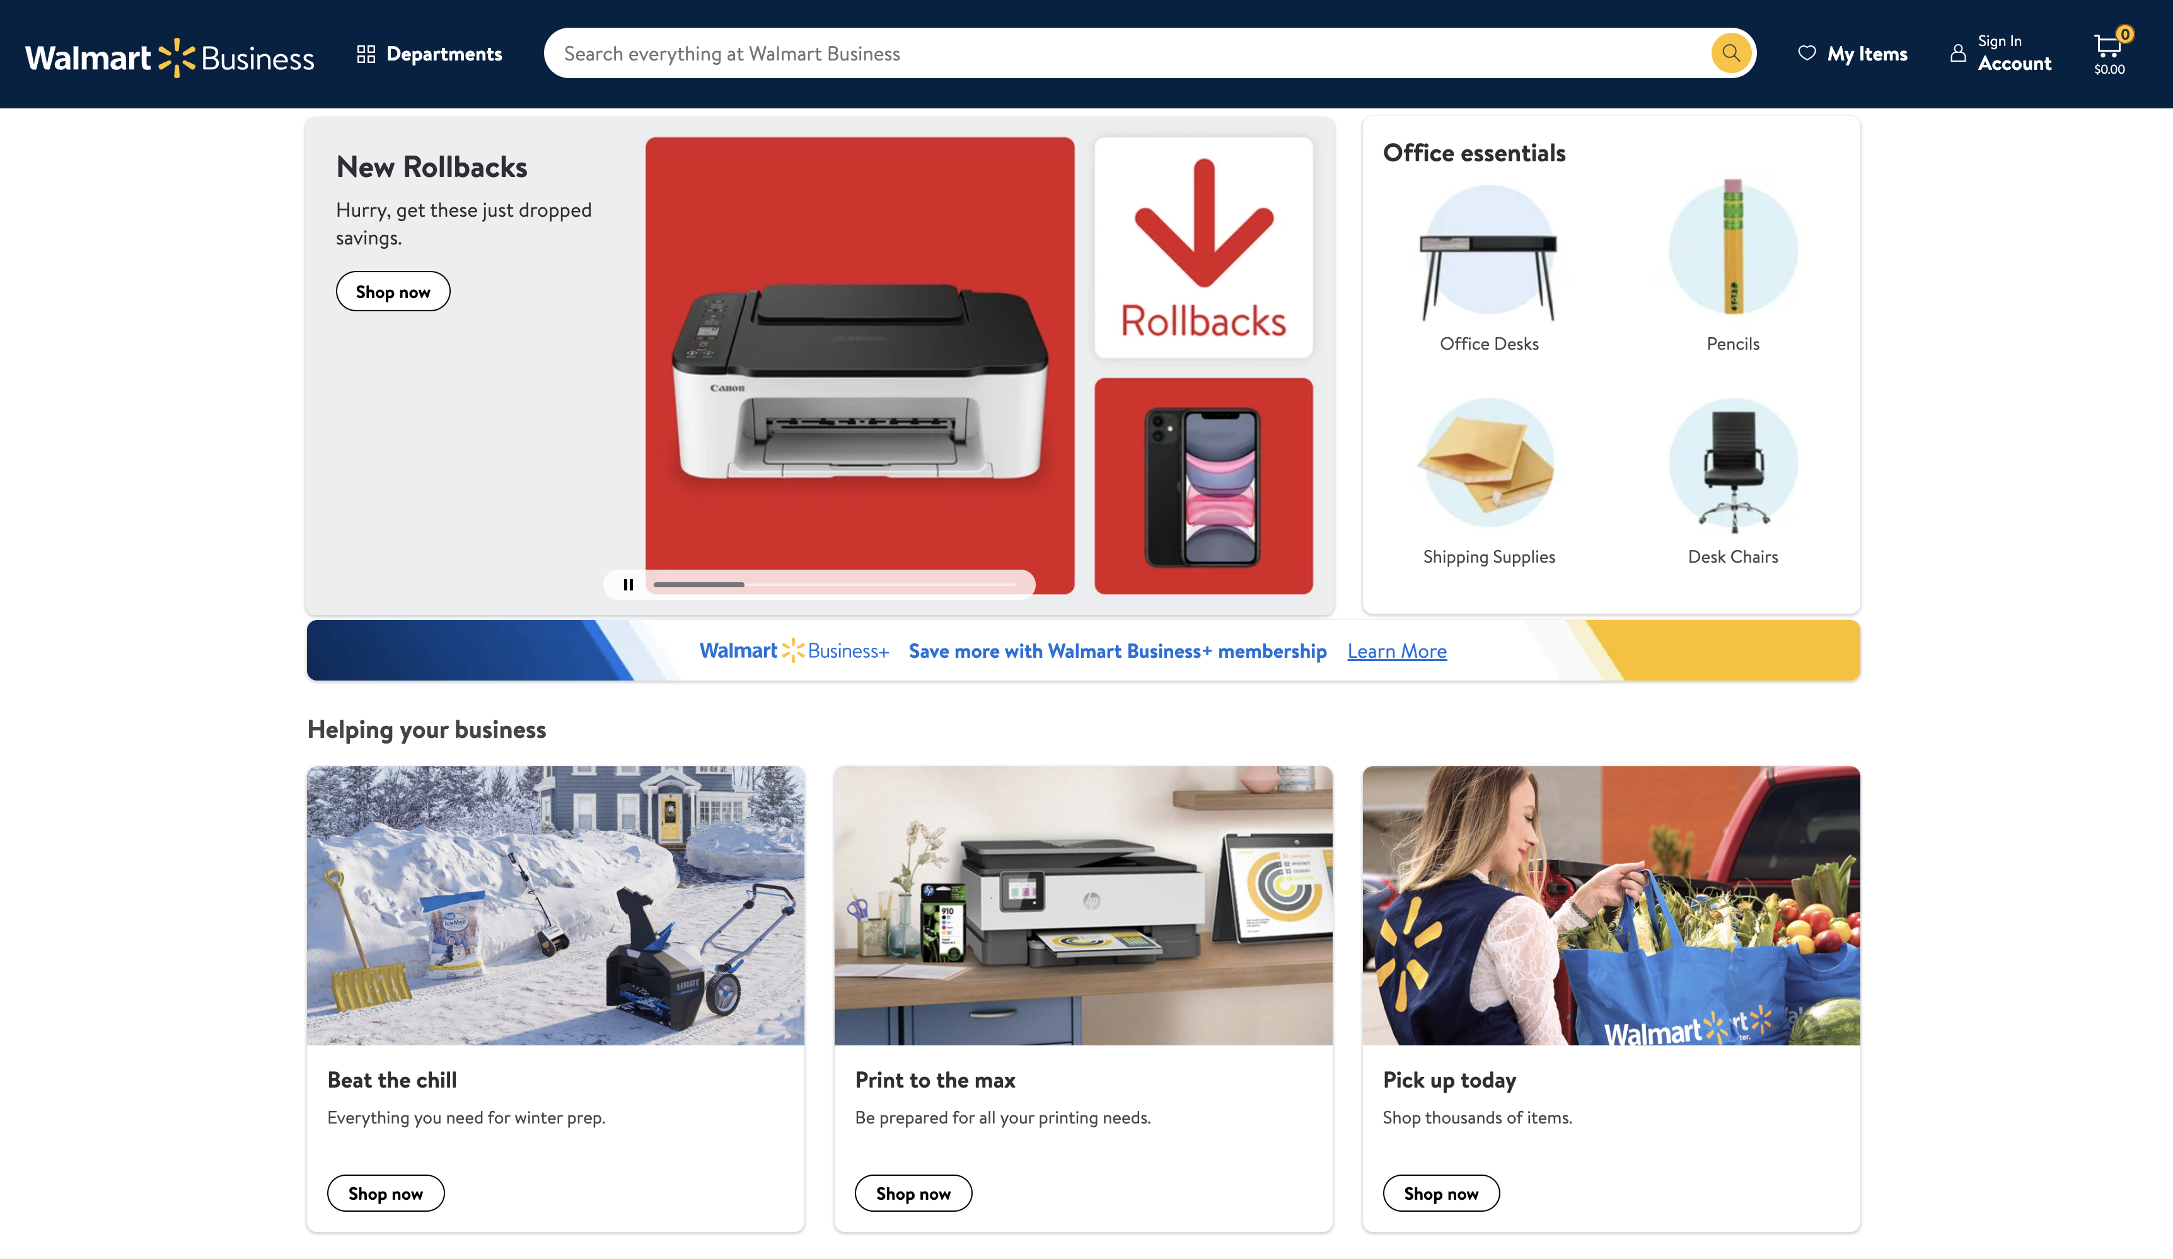
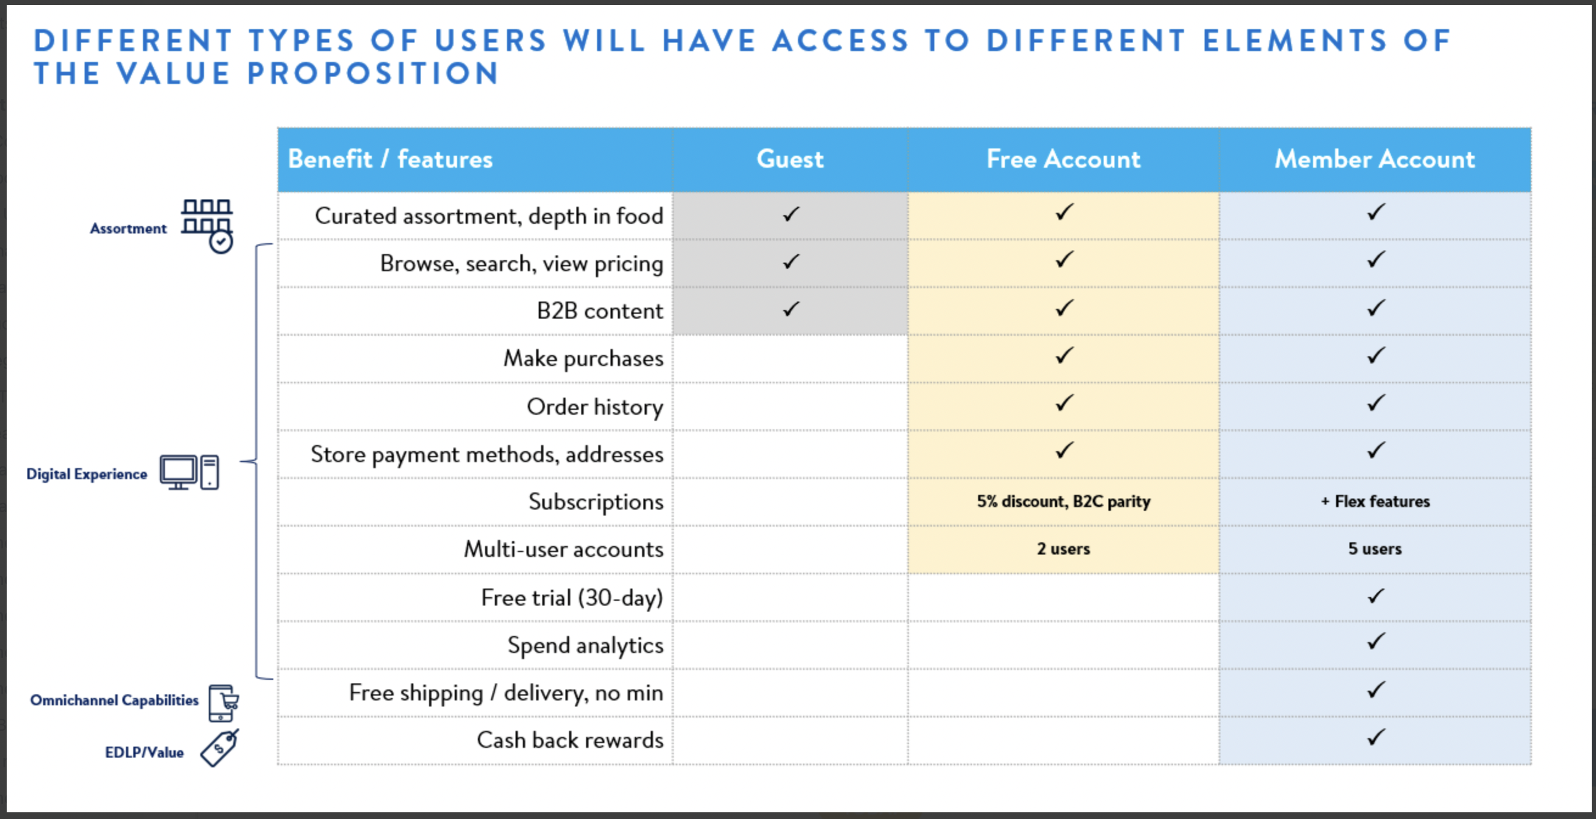
VALUE ADD FOR CUSTOMERS

Slide 4
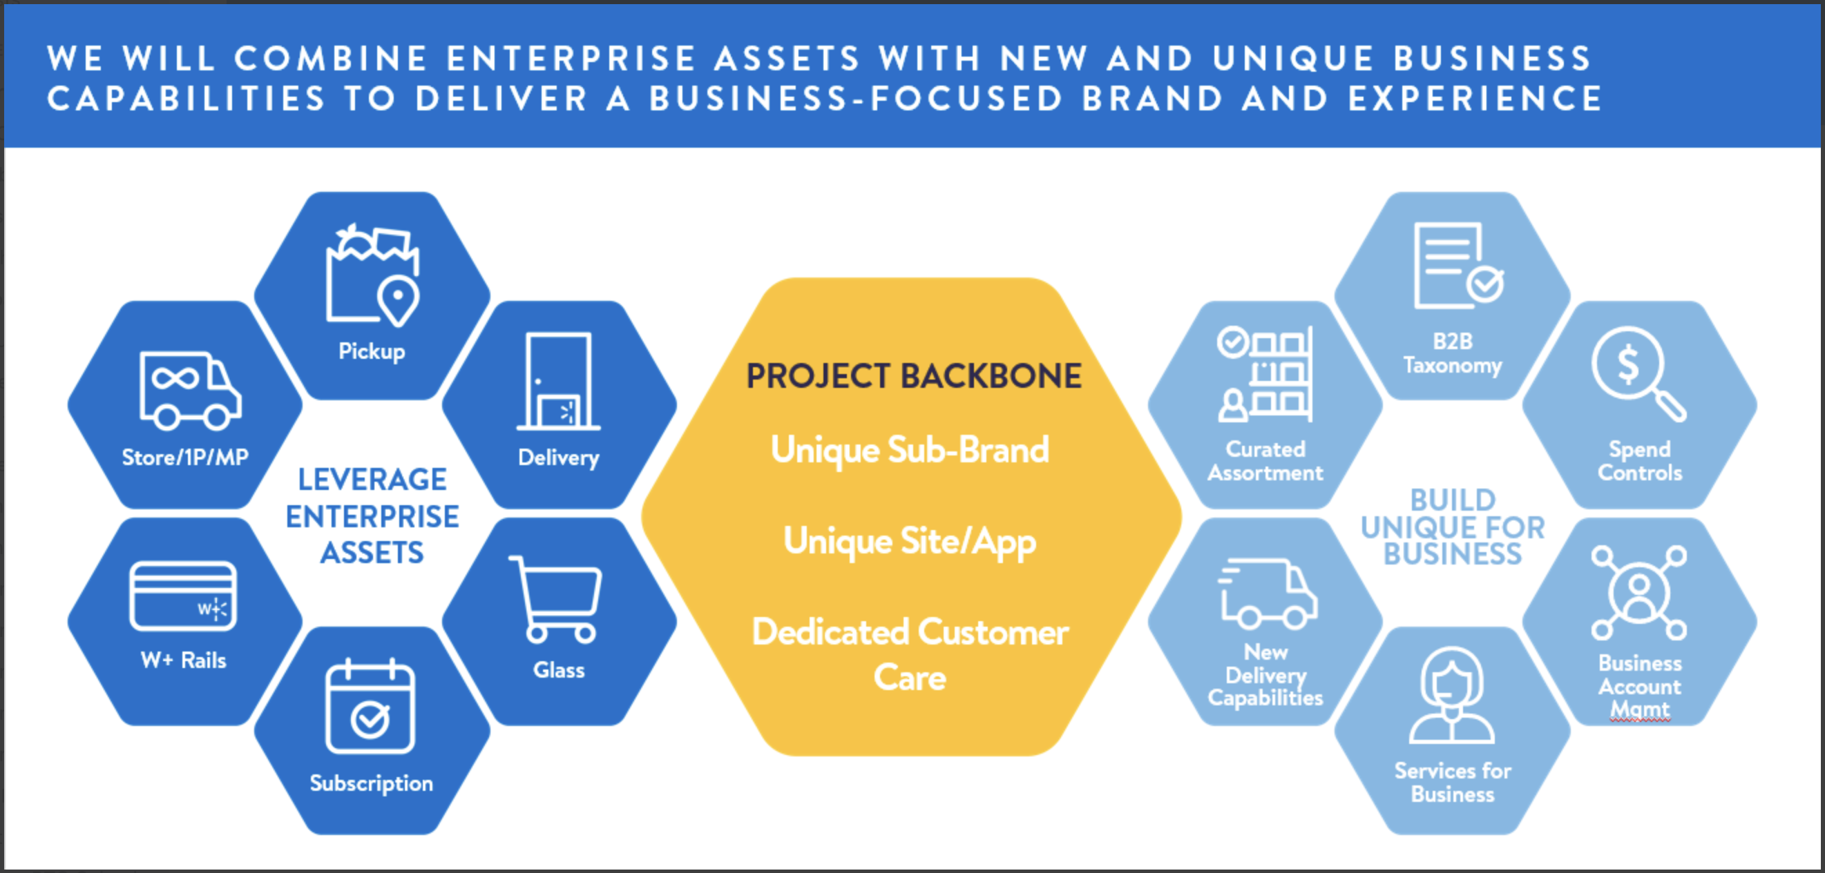
POTENTIAL RISKS
Customers could buy products from Walmart Business and re-sell them for a much higher price on other markets such as Amazon, Facebook, etc.
Use their business to cover up illegit money for taxation purposes

Slide 5
The B2B Dashboard
- The purpose of this Dashboard is to track Organization Registrations and provide a drill down of the auto-decision and manual decision process

Slide 6
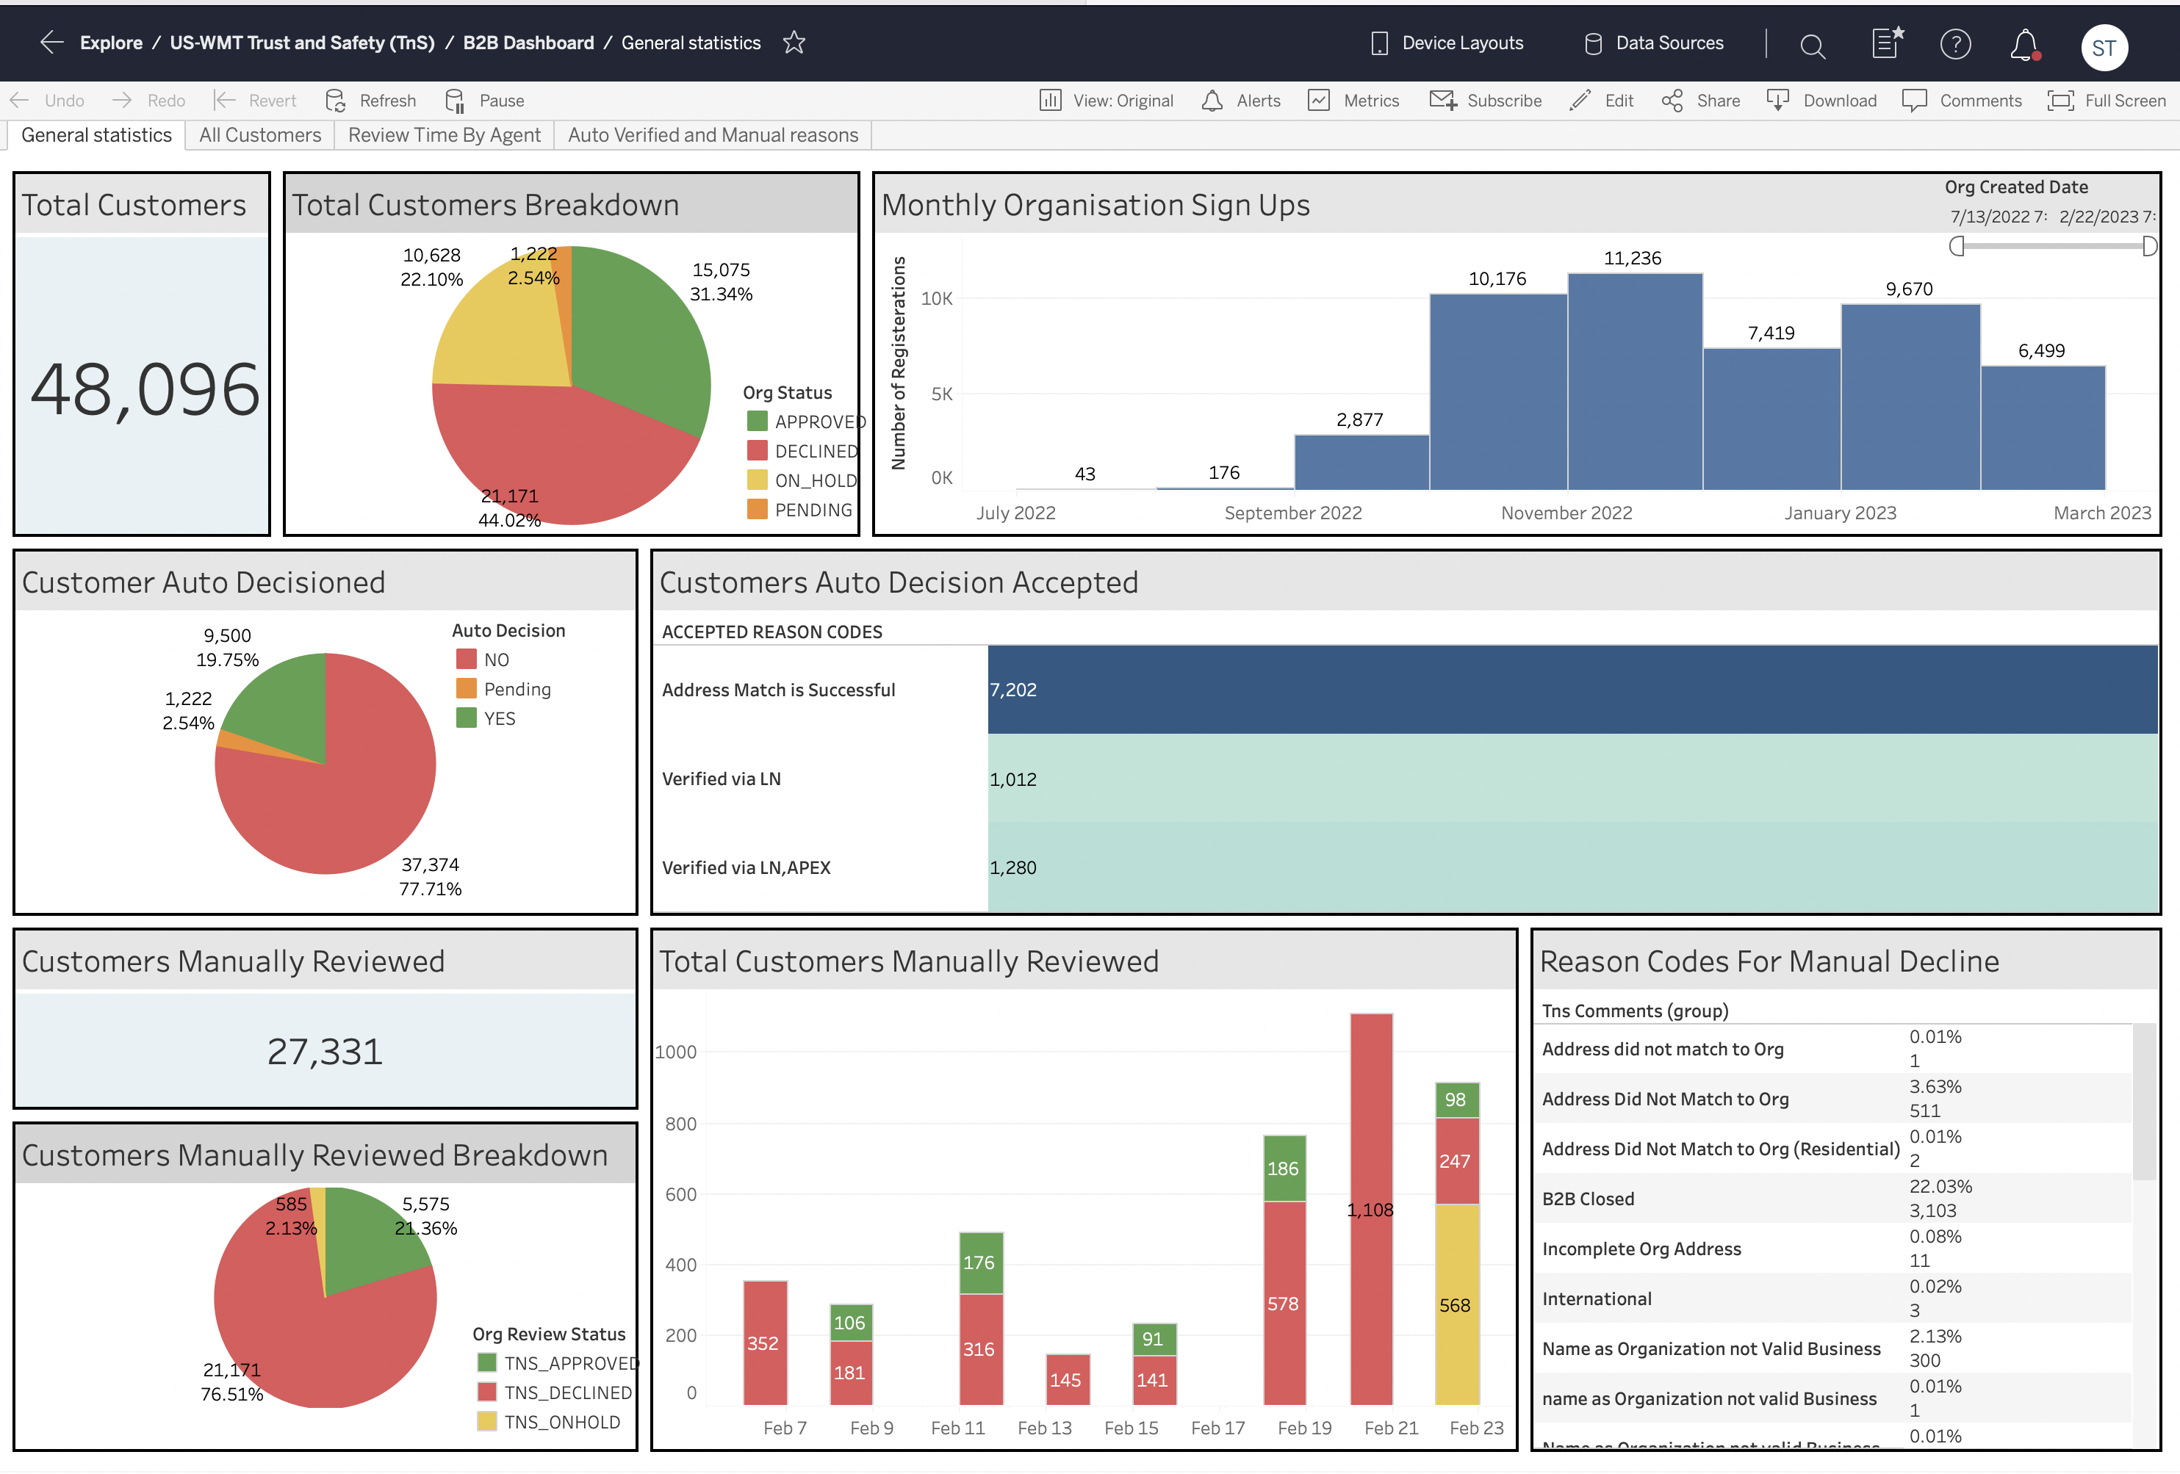

Slide 7
Fraudulent patterns

Slide 8
Date File Received | Script | Nicole | Accuracy
2023-03-22 | 122 | 121 | 99.2%
2023-03-30 | 53 | 52 | 98.1%
Same Address to different orgs with similar emails
mushtaq | 13103 Grantham Ridge Court |  | Rosharon | TX | 77583 | southmoon591@gmail.com
jdcvbnhfd | 13103 Grantham Ridge Court |  | Rosharon | TX | 77583 | southmoon590@gmail.com
.5741874 | 13103 Grantham Ridge Court |  | Rosharon | TX | 77583 | southmoon590@mail.com
@Yandex.com with first name or non-business name followed by LLC
unicorn llc | 33669 North Christa Drive |  | Ingleside | IL | 60041 | amirxu63@yandex.com
florence llc | 1214 North Foster Road |  | San Antonio | TX | 78219 | amirxu84@yandex.com
racky llc | 55421 Rae Drive |  | Richfield | MN | 55423 | amirxu82@yandex.com
kandy llc | 5513 Hudson Avenue |  | West New York | NJ | 07093 | amirxu76@yandex.com
All Caps Outlook email Domains
ECOMMCONCEPTS LLC | 36827 WEIDEMAN ST |  | CLINTON TWP, | MI | 48035 | ecommconcepts.wm@outlook.com
UNICORN LOVER ENTERPRISES | 19104 Long Lake Ranch Boulevard |  | Lutz | FL | 33558 | unicornlover.wm@outlook.com
First Names or Gibberish followed by Inc Using Hotmail
Intuit Inc | 5660 New Northside Drive Northwest |  | Atlanta | GA | 30328 | intuitinc27ave@hotmail.com
Richard inc | 112 E Nancy Ln |  | Nashville | IL | 62263 | claimclub829@hotmail.com
Jeri INC | 4894 Hancock St |  | Montague | MI | 49437 | threetwo244@hotmail.com
Similar emails to different Org names
Universal Chemicals, Llc | 100 Hackensack Avenue |  | Kearny | NJ | 07032 | reggiekray.22@gmail.com
Ramon Leon Md, Llc | 7540 SW 61st Ave |  | Miami | FL | 33143 | reggiekray.11@gmail.com
Affordable Brush Cutting, Llc | 3058 Saturn Circle |  | North Fort Myers | FL | 33903 | reggiekray.33@gmail.com
Lcd Financial Service, Llc | 216 Palmetto Dunes Circle |  | Naples | FL | 34113 | reggiekray.66@gmail.com
Dot LLC Org names jibberish email domains
lucaslucile.llc | 8001 W Hillsborough Ave |  | Tampa | FL | 33615 | walmartln@gmail.com
kevy.po.llc | 1 Main St |  | Lost Springs | WY | 82227 | ammarworkin.g@gmail.com
Gibberish in Org names or ZX (Additional) With similar domain names.
kumar kumar | ZXP Technologies |  | Highlands | TX | 77562 | kumar@travellingarmy.com
NORAN NORAN | ZXP Technologies |  | Highlands | TX | 77562 | noran@demaxes.com
MARLON MARLON LLC | ZXP Technologies |  | Highlands | TX | 77562 | marlon@travellingarmy.demaxes.com
Same org Name different address with Similar email domain and different phone numbers
American P | 245 Ridge Point Ct |  | Alpharetta | GA | 30022 | annetemlancaster001@yahoo.com
American P | 1718 Edgewood Dr |  | Elizabeth City | NC | 27909 | arslanprinse01@gmail.com

Slide 9
NEXT STEPS & LINKS
NEXT STEPS:
Launch the automated customer flagging process to use it in the week over week manual review
Enhance script to identify and flag bot registrations
LINKS:
B2B Dashboard: https://gist.walmart.com/#/views/B2BDashboard/Generalstatistics?:iid=1
Fraud Pattern Detection Script: https://console.dx.walmart.com/element/workzone/projects/7742/notebooks/51011

Slide 10
Thankyou!!

